Slide 1
Artificial Intelligence
Introduction

Slide 2
What is AI?
What AI can do today?

Slide 3
What is AI?
The term artificial intelligence was first used in 1956
Dartmouth College professor John McCarthy coined the term "artificial intelligence" and organized an intensive summer workshop bringing together leading experts in the field.
The field of artificial intelligence, or AI attempts to build intelligent entities

Slide 4
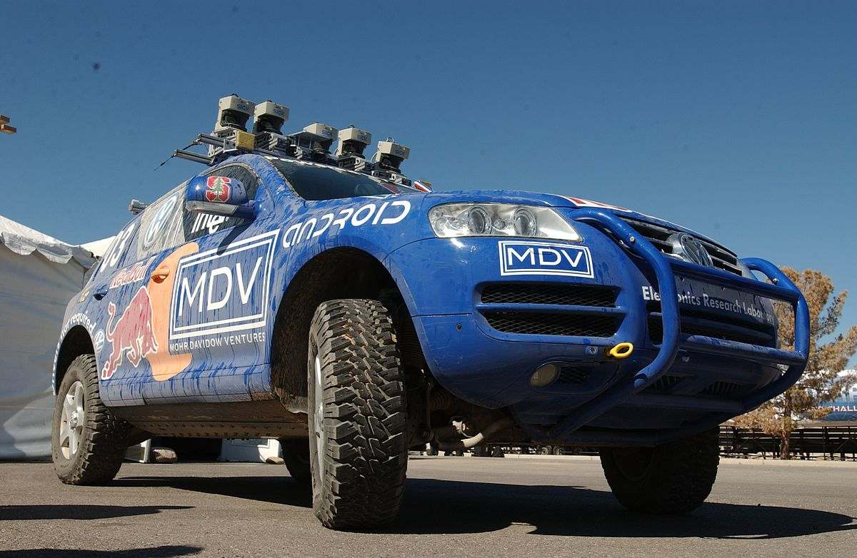
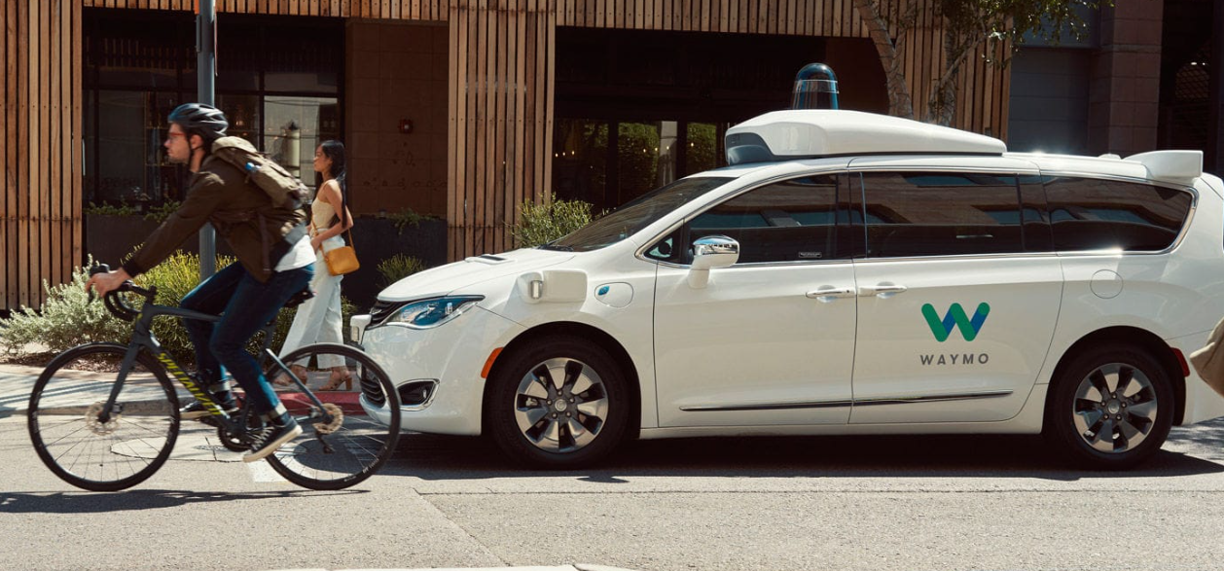
What can AI do today?
https://en.wikipedia.org/wiki/Stanley_(vehicle)
Robotic vehicles:
A driverless robotic car STANLEY sped through the rough terrain of the Mojave dessert to win the 2005 DARPA Grand Challenge
In October 2020, Waymo launched a geo-fenced driverless ride hailing service in Phoenix, Arizona. The cars are being monitored in real-time by a team of remote engineers, and there are cases where the remote engineers need to intervene.
Stanley parked after the 2005 DARPA Grand Challenge
https://waymo.com/
Notes:
A driverless robotic car named STANLEY sped through the rough terrain of the Mojave dessert at 22 mph, finishing the 132-mile course first to win the 2005 DARPA Grand Challenge.
In 2018, Waymo test vehicles passed the landmark of 10 million miles driven on public roads without a serious accident, with the human driver stepping in to take over control only once every 6,000 miles. Soon after, the company began offering a commercial robotic taxi service. In October 2020, Waymo launched a geo-fenced driverless ride hailing service in Phoenix, Arizona. The cars are being monitored in real-time by a team of remote engineers, and there are cases where the remote engineers need to intervene

Slide 5
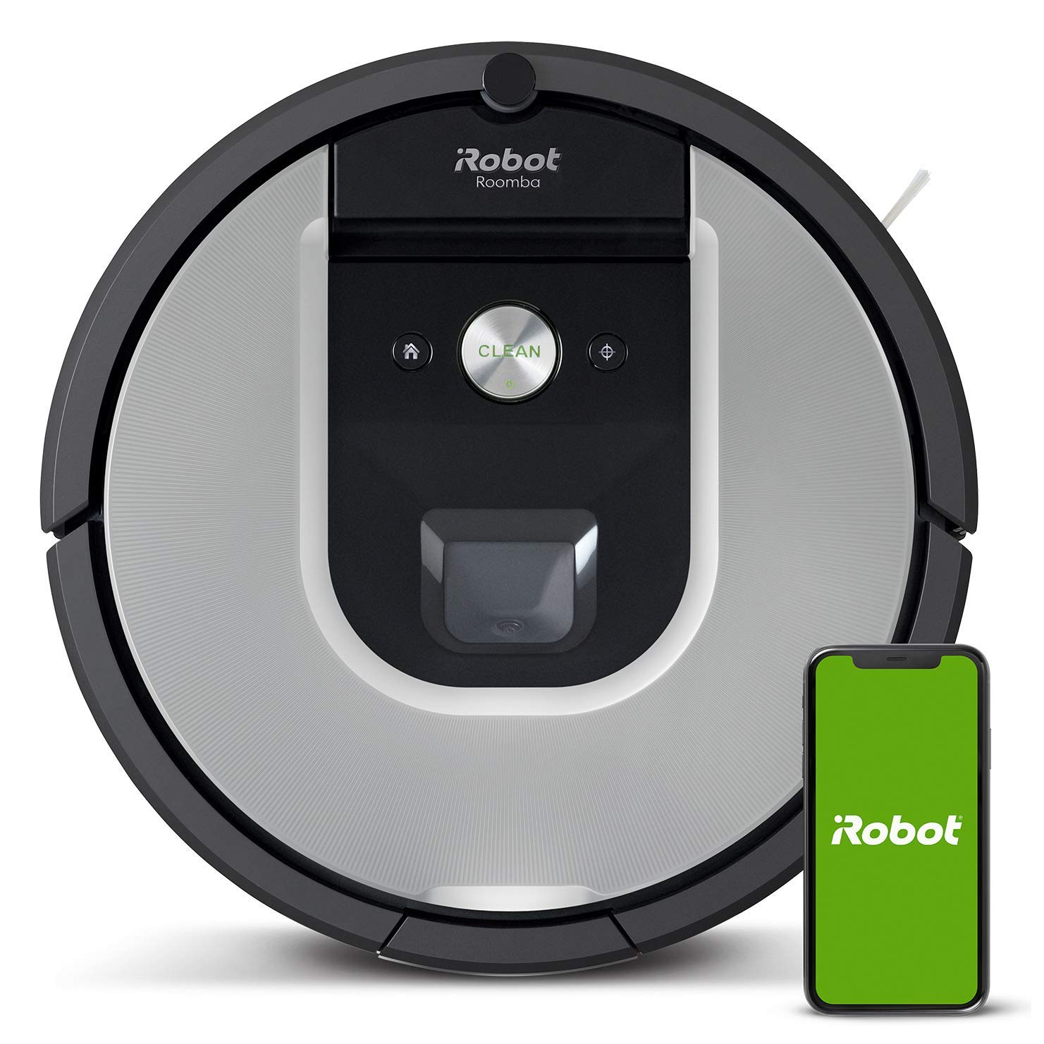
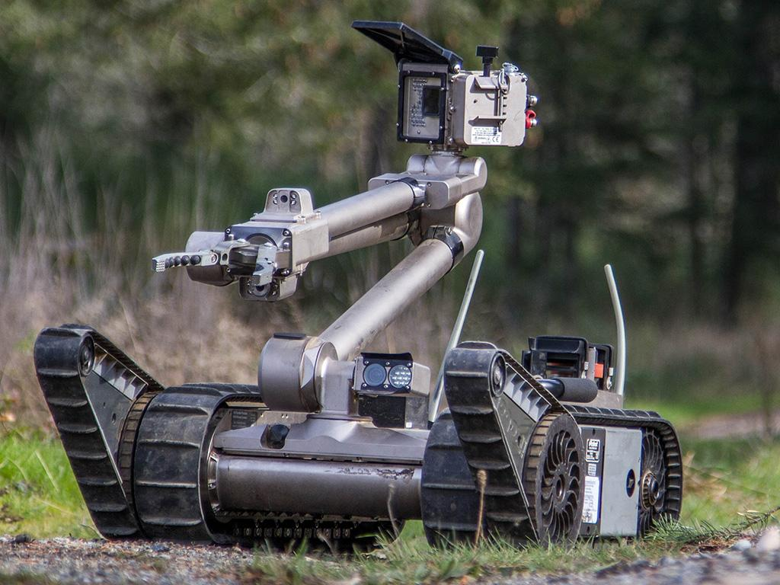
What can AI do today?
Robotics:
Roomba robotic vacuum cleaners for home use
PackBot to handle hazardous materials, clear explosives, and identify the location of snipers
https://www.amazon.in/iRobot-Roomba-Vacuum-Cleaning-Robot/dp/B084BJWFN6
Roomba
https://robots.ieee.org/robots/packbot/
PackBot

Slide 6
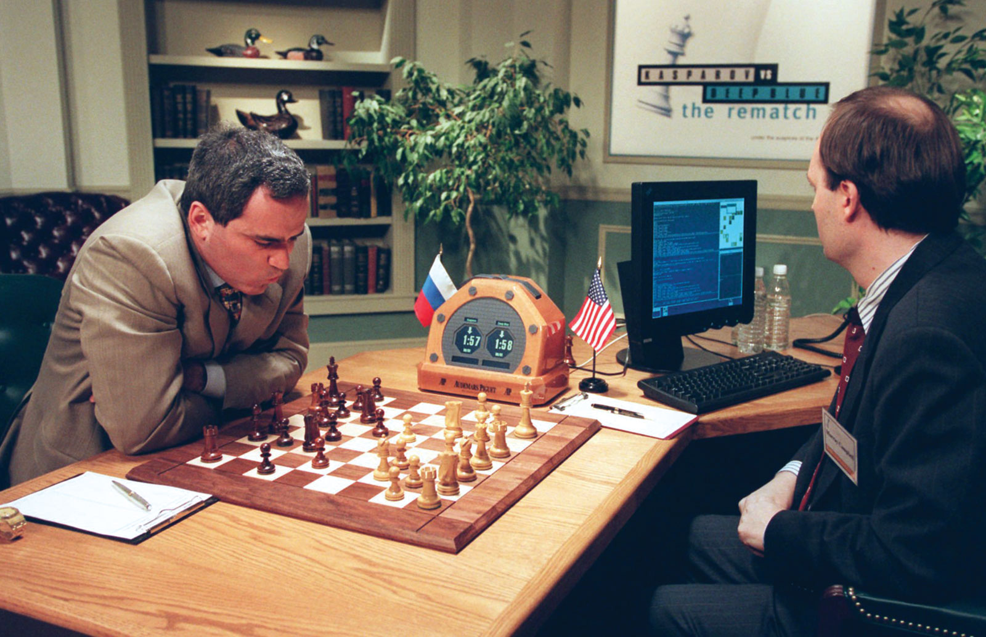
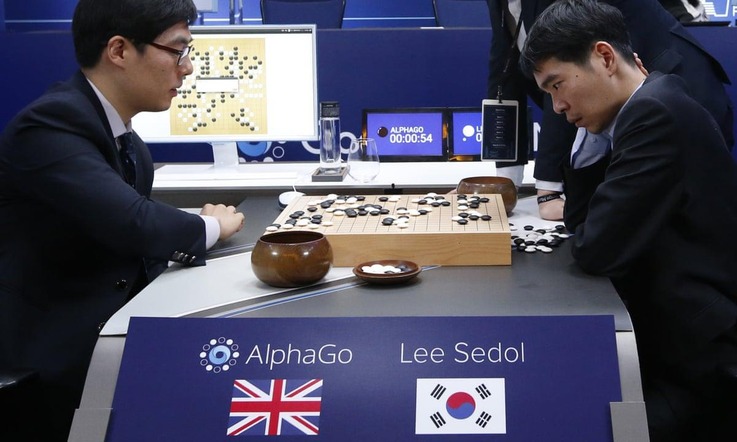
What can AI do today?
Game playing
Deep Blue defeated world chess champion Garry Kasparov in 1997
ALPHAGO beat human in the board game Go in 2017
ALPHAZERO learned through self-play alone to defeat all opponents, human and machine, at Go, chess, and shogi in 2018
Human champions have been beaten by AI systems at games as diverse as Jeopardy, poker etc.
https://www.britannica.com/topic/Deep-Blue
Deep Blue
AlphaGo
https://www.theguardian.com/technology/2016/mar/15/alphago-what-does-google-advanced-software-go-next
Notes:
At the 2017 Future of Go Summit, the Master version of AlphaGo beat Ke Jie, the number one ranked player in the world at the time, in a three-game match in the board game Go
ALPHAZERO, used no input from humans (except for the rules of the game), and was able to learn through self-play alone to defeat all opponents, human and machine, at Go, chess, and shogi in 2018
Human champions have been beaten by AI systems at games as diverse as Jeopardy, poker etc.

Slide 7
What can AI do today?
Natural Language Processing (NLP)
Machine Translation
Speech Recognition
Spam filtering
…
Notes:
“Natural language processing strives to build machines that understand and respond to text or voice data—and respond with text or speech of their own—in much the same way humans do” - https://www.ibm.com/cloud/learn/natural-language-processing
Because the spammers are continually updating their tactics, it is difficult for a static programmed approach to keep up

Slide 8
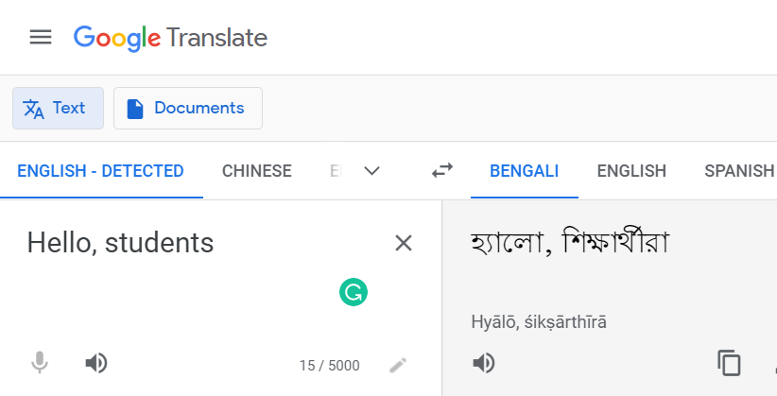
What can AI do today?
Machine translation
Enable the reading of documents in over 100 languages, including the native languages of over 99% of humans, and render hundreds of billions of words per day for hundreds of millions of users. While not perfect, they are generally adequate for understanding. Code Automation
https://translate.google.com/

Slide 9

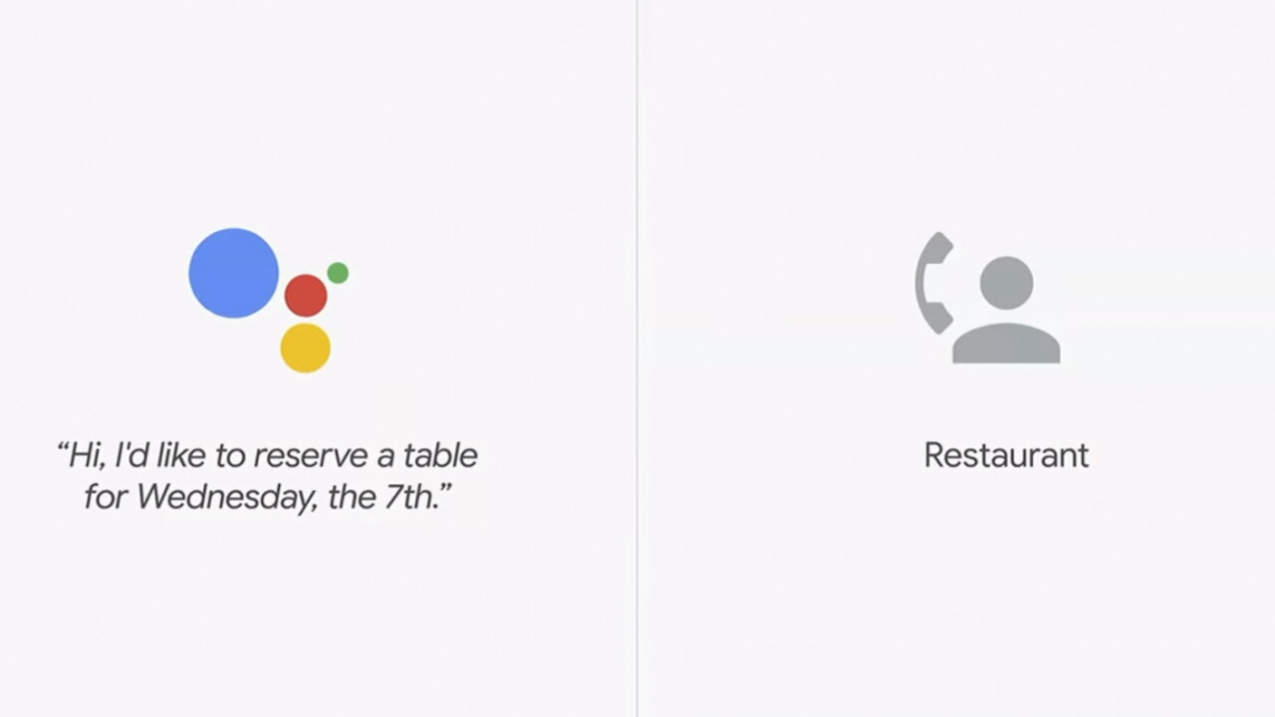
What can AI do today?
Speech recognition
About a third of computer interaction worldwide is now done by voice
Skype provides real-time speech-to-speech translation in ten languages
Alexa, Siri, Cortana, and Google offer assistants that can answer questions and carry out tasks for the user
Google Duplex service uses speech recognition and speech synthesis to make restaurant reservations for users
https://zayzay.com/news/skype-now-real-time-translation/

Slide 10
What can AI do today?
Code automation
comment to code
text to app

Slide 11

What can AI do today?
Image understanding
Image captioning
Facial recognition
Optical character recognition (OCR)
and many more…
Computer Vision
A person riding a motorcycle on a dirt road

Slide 12
What can AI do today?
Autonomous planning and scheduling:
EUROPA planning toolkit used for daily operations of NASA’s Mars rovers
SEXTANT – autonomous navigation in deep space, beyond the global GPS system
Uber and Google Maps provide
Quick driving directions considering current and predicted future traffic conditions
Recommendations
Used by Amazon, Facebook, Netflix, Spotify, YouTube, Walmart, and many more
Medicine
Equal or exceed expert doctors at diagnosing many conditions, e.g., Alzheimer’s disease, metastatic cancer, skin diseases etc.
Notes:
the EUROPA planning toolkit (Barreiro et al., 2012) is used for daily operations of NASA’s Mars rovers and the SEXTANT system (Winternitz, 2017) allows autonomous navigation in deep space, beyond the global GPS system.

Slide 13
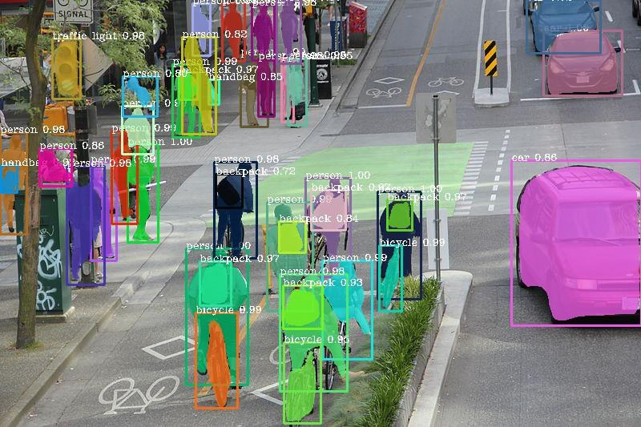
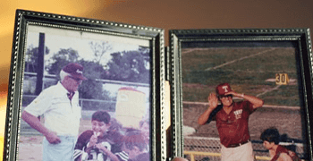
What can AI do today?
https://www.kaggle.com/c/deepfake-detection-challenge/discussion/121223
https://towardsdatascience.com/image-segmentation-with-six-lines-0f-code-acb870a462e8
Deep Fake
https://imagecolorizer.com
image segmentation
This AI Clones Your Voice After Listening for 5 Seconds 🤐 https://youtu.be/0sR1rU3gLzQ

Slide 14
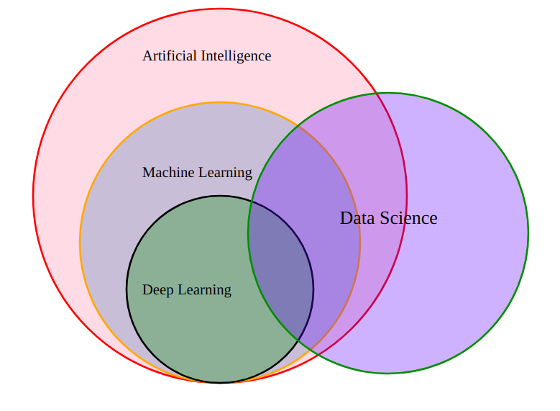
AI vs ML vs DL
Artificial Intelligence
build intelligent programs and machines that can creatively solve problems
Machine Learning
provides systems the ability to automatically learn and improve from experience without being explicitly programmed
Deep Learning
uses the neural networks
https://hctechzoo.xyz/wp-content/uploads/2020/08/z-1.png
More resources: https://youtu.be/QizsAE4fBpQ

Slide 15
Brief Timeline of AI
1956 – The Dartmouth Conference
Dartmouth College professor John McCarthy coined the term “artificial intelligence”
1991 – The birth of the Internet
1997 – Deep Blue defeats world chess champion Garry Kasparov
2002 –AI entered the home in the form of Roomba, a vacuum cleaner.
2005 – The DARPA Grand Challenge
A driverless robotic car STANLEY sped through the rough terrain of the Mojave dessert to win the 2005 DARPA Grand Challenge
2011 – IBM Watson’s Jeopardy! Victory
Cognitive computing engine Watson won the TV game show Jeopardy
2016 – AlphaGo goes where no machine has gone before
2018 – Self-driving cars hit the roads
source: https://www.forbes.com/sites/bernardmarr/2018/12/31/the-most-amazing-artificial-intelligence-milestones-so-far/?sh=e8ea0297753e
https://www.javatpoint.com/history-of-artificial-intelligence

Slide 16
The History of Artificial Intelligence (AIMA 1.3)
1.3.1 The inception of artificial intelligence (1943–1956)
1.3.2 Early enthusiasm, great expectations (1952–1969)
1.3.3 A dose of reality (1966–1973)
1.3.4 Expert systems (1969–1986)
1.3.5 The return of neural networks (1986–present)
1.3.6 Probabilistic reasoning and machine learning (1987–present)
1.3.7 Big data (2001–present)
1.3.8 Deep learning (2011–present)
source: AIMA, 4th Edition

Slide 17
Risks and Benefits of AI (AIMA 1.5)
Lethal autonomous weapons
Surveillance and persuasion
2016 US presidential election
Models trained on biased Data
Impact on employment
Safety-critical applications

Slide 18
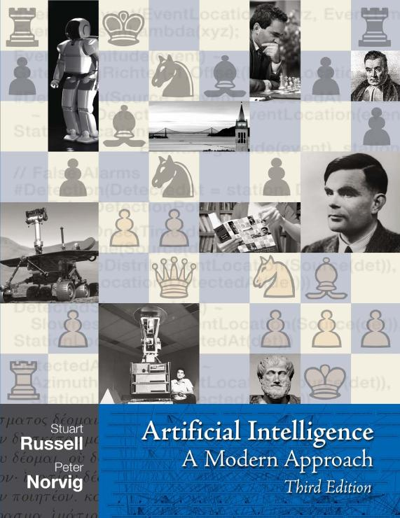
http://aima.cs.berkeley.edu/

Slide 19
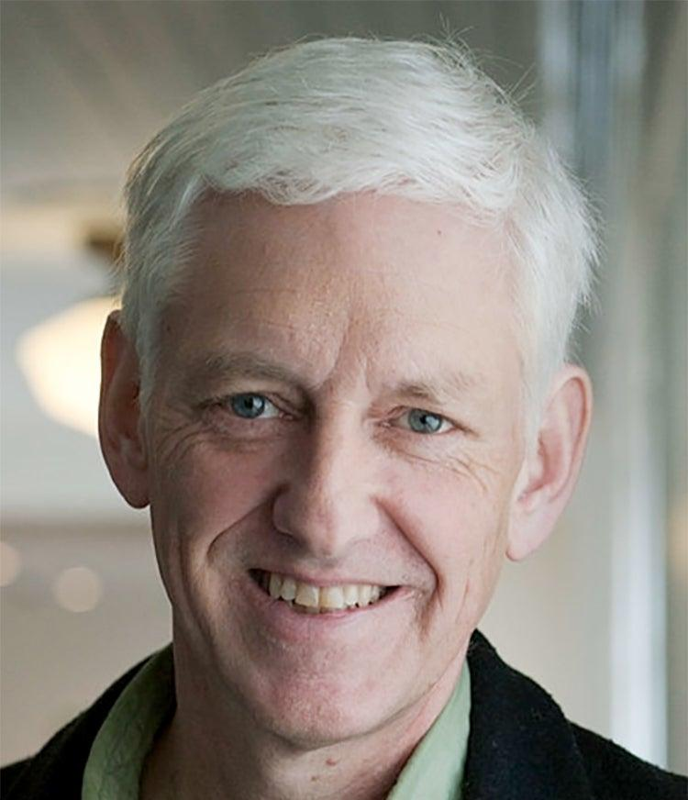
Who is Peter Norvig?
https://norvig.com/bio.html

Slide 20
Good Resources to Explore!
AlphaGo - The Movie | Full award-winning documentary https://www.youtube.com/watch?v=WXuK6gekU1Y
https://theconversation.com/why-the-feds-are-investigating-teslas-autopilot-and-what-that-means-for-the-future-of-self-driving-cars-166307
Notes:
https://www.slideshare.net/imamhossain75054/presentations/2

